Slide 1
Software Engineering Gaps in Agentic Development
Khaled Ahmed

Slide 2
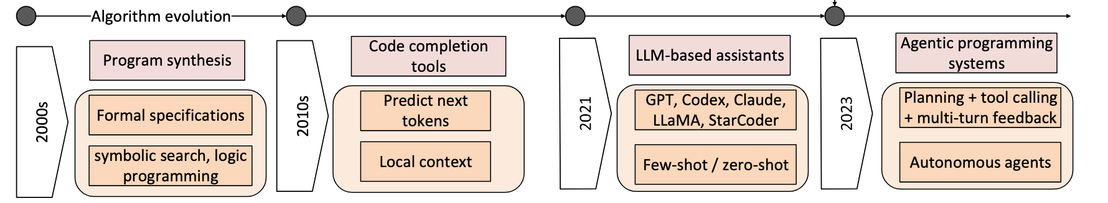
Generative AI in software engineering
*
Research Goal
Heavy reliance on GenAI in building software is now a reality
How to ensure software is trustworthy, good quality, maintainable, ..?
Need to ensure good software engineering (SE) practices in this new paradigm
* Wang H, Gong J, Zhang H, Xu J, Wang Z. “AI Agentic Programming: A Survey of Techniques, Challenges, and Opportunities”. ArXiv, 2025
2

Slide 3
What are good SE practices*?
Specifications & Requirements: elicitation, specification, validation
Design: architecture, interface, data-structures, algorithms
Implementation: correctness, efficiency, robustness, usability, maintainability
Verification and Validation: testing, program analysis, model checking, prototyping, etc.
Maintenance & Evolution: corrective, perfective, adaptive, preventative
Question 1: In GenAI era, how to ensure good SE practices?
* Many content taken from Software Engineering course (CPEN 321), by Julia Rubin, The University of British Columbia (UBC)
2

Slide 4

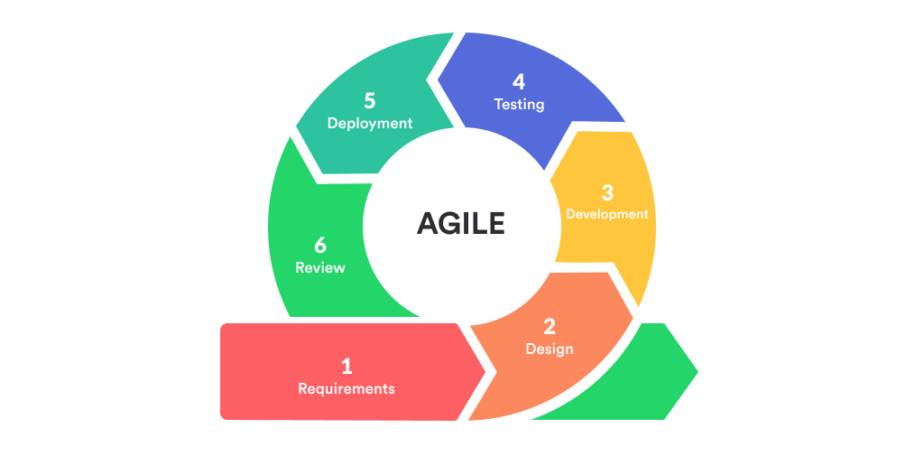
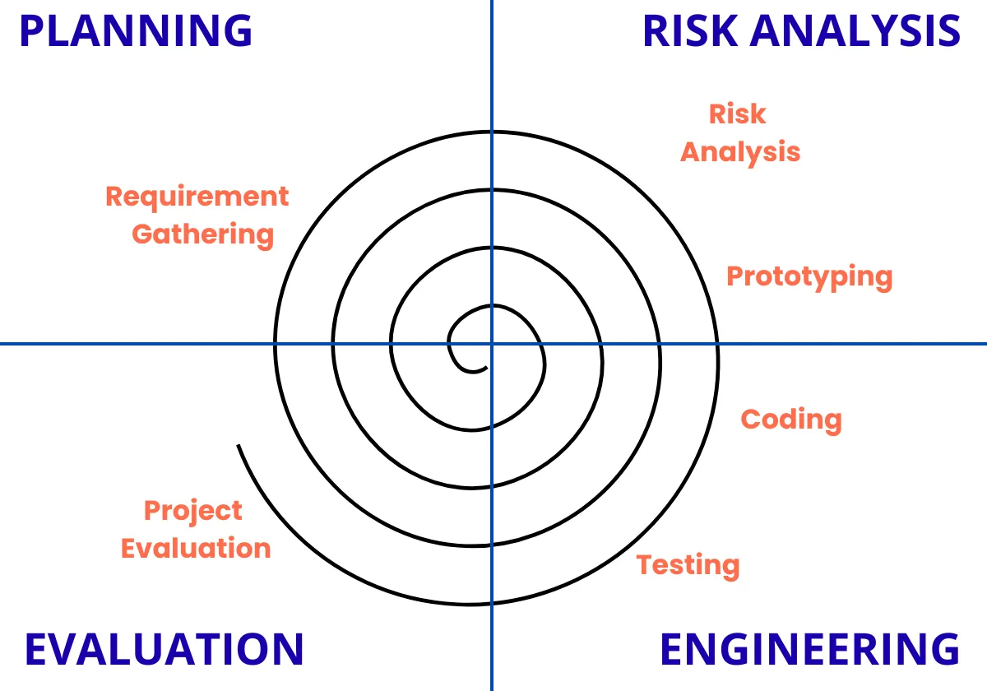
What is the SE process?
Defines who is doing what, when, and how in development of system.
Code & Fix
Waterfall
Staged delivery
Spiral
Agile
Requirements
Requirements
Code, test, deliver
Design
Design
Code, test, deliver
Implementation
Code, test, deliver
Verification
Maintenance
Q2: For GenAI, which process to follow? Do we need a new process?
Q3: Who (developer or AI agent) should be more responsible in which stage?
2

Slide 5
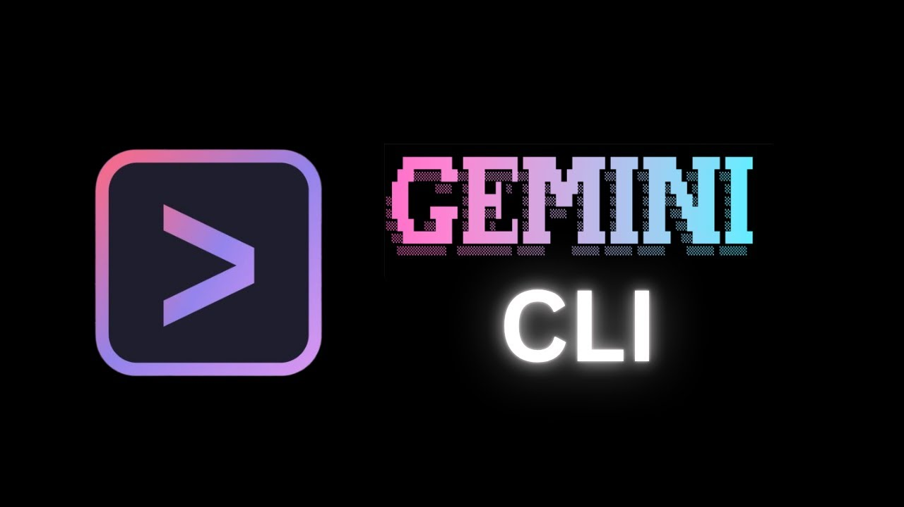

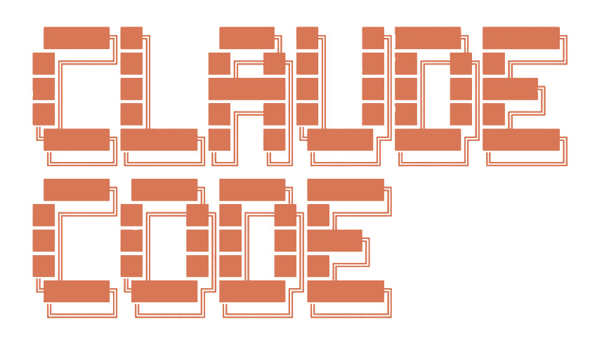
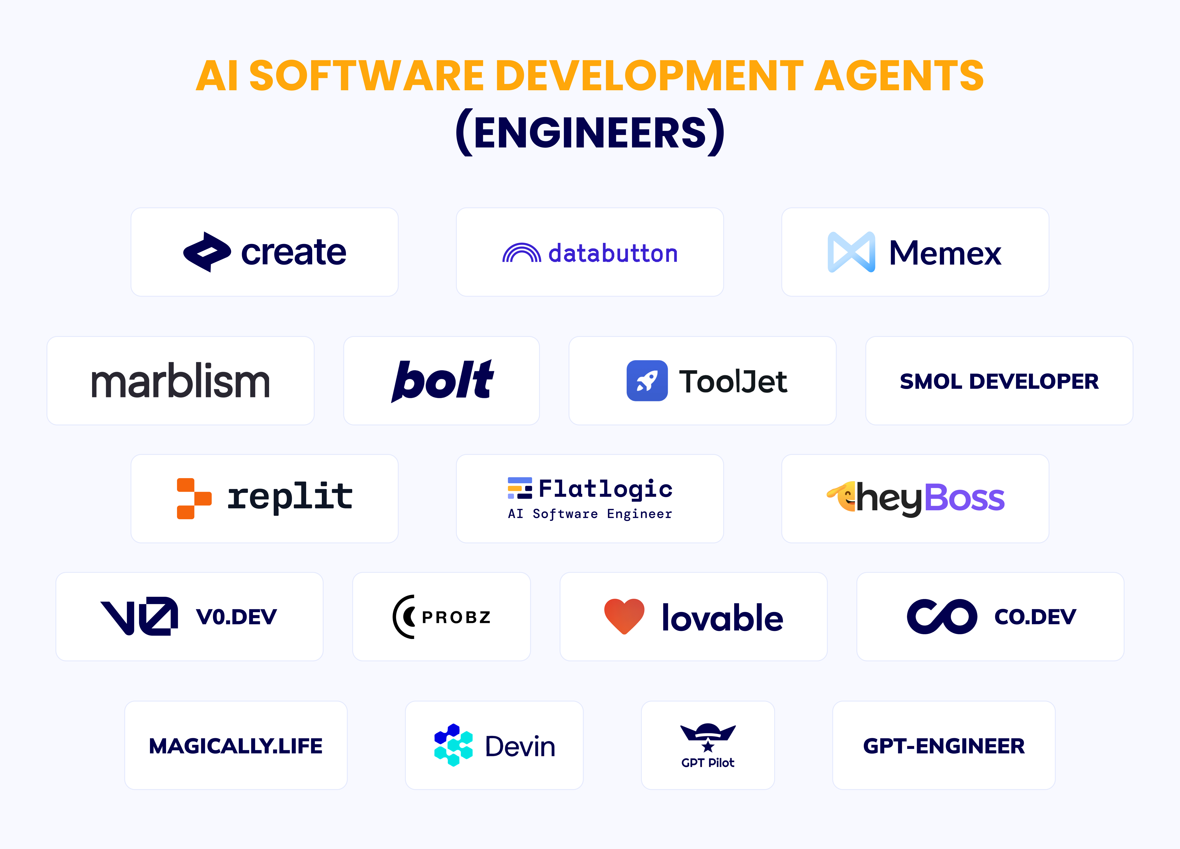






State of current software development agents
TONGYI Lingma
All promise using simple prompts to build full systems: “vibe coding”
* https://github.com/flatlogic/awesome-ai-software-development-agents
2

Slide 6
Agent capabilities
Can process entire codebase, edit multiple files, write and run tests, run terminal commands, run tests, resolve merges, commit, and pull
Can create a full plan before executing it, verifies results with tests
Risks:
large volume of generated code, hard for human to quality check all of them
Hard to check code quality, check code is trustworthy
AI agent may or may not follow all workflow instructions
Cannot ensure good SE practices were followed
2

Slide 7
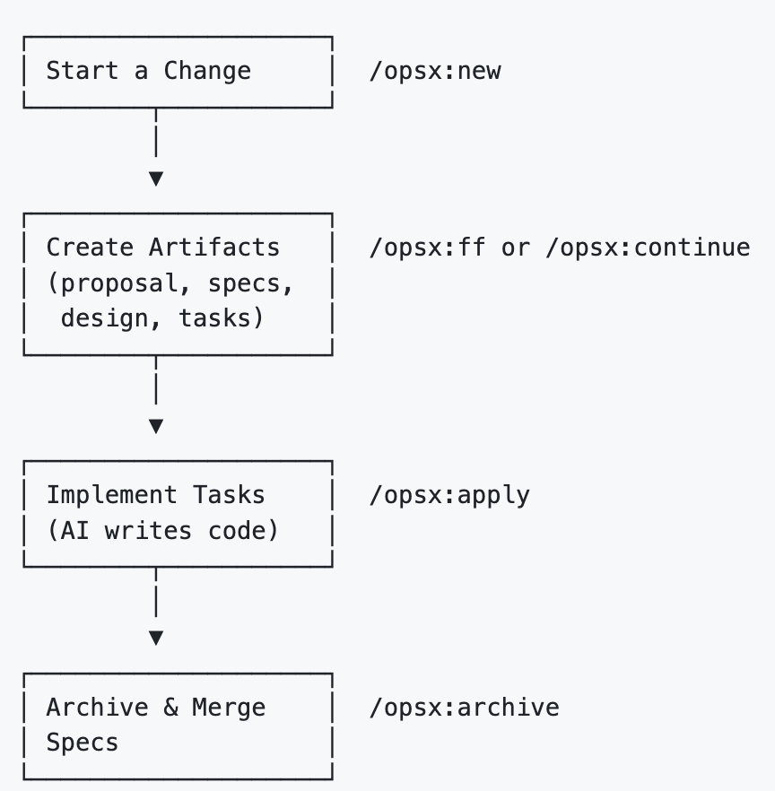
Solutions to enforce SE practices
OpenSpec [1]: Enforces requirement specification before design and implementation
Others: everything claude code[2], SpecKit [3], Superpowers[4]
[1] https://openspec.dev/
[2] https://github.com/affaan-m/everything-claude-code
[3] https://github.com/github/spec-kit
[4] https://github.com/obra/superpowers
2

Slide 8
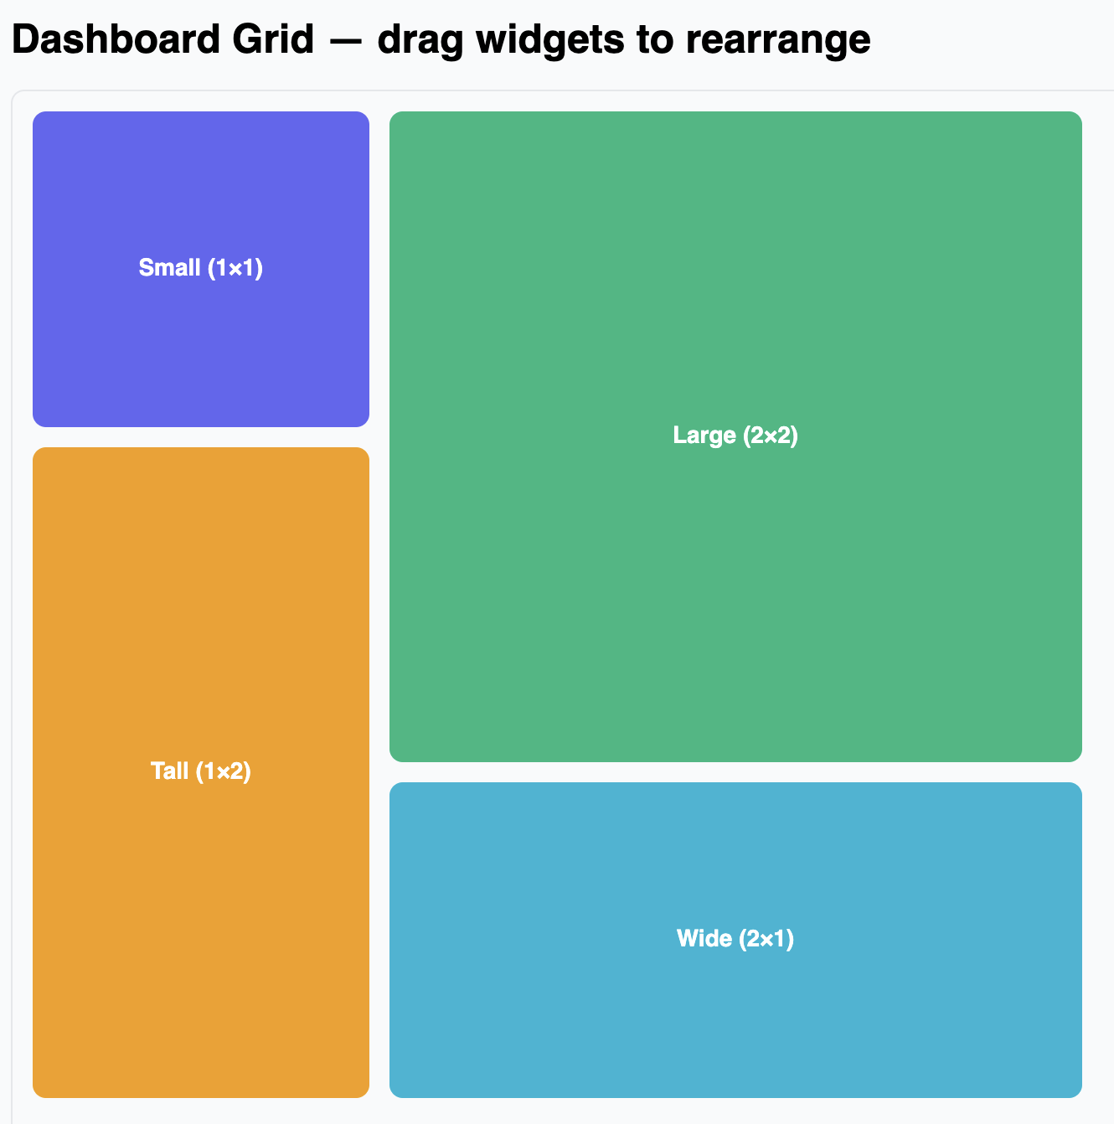
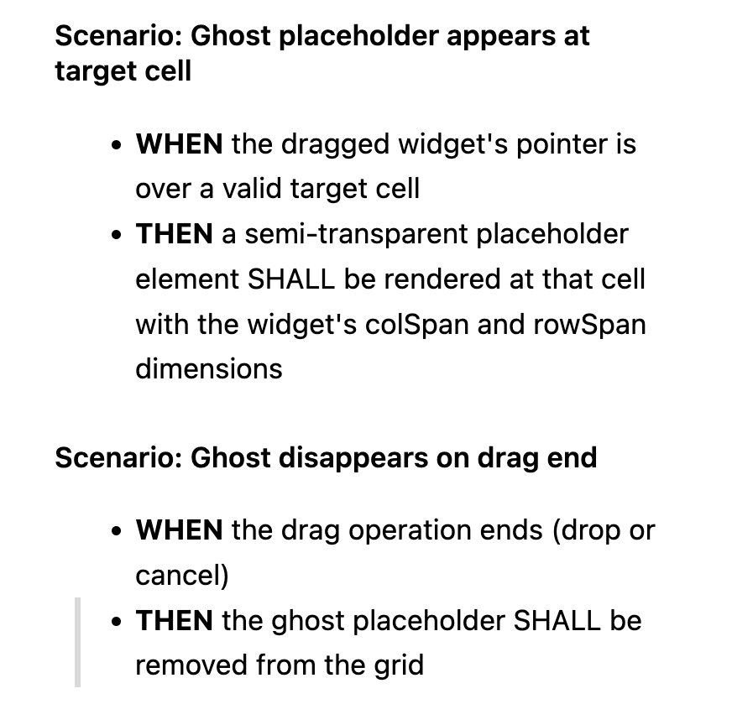
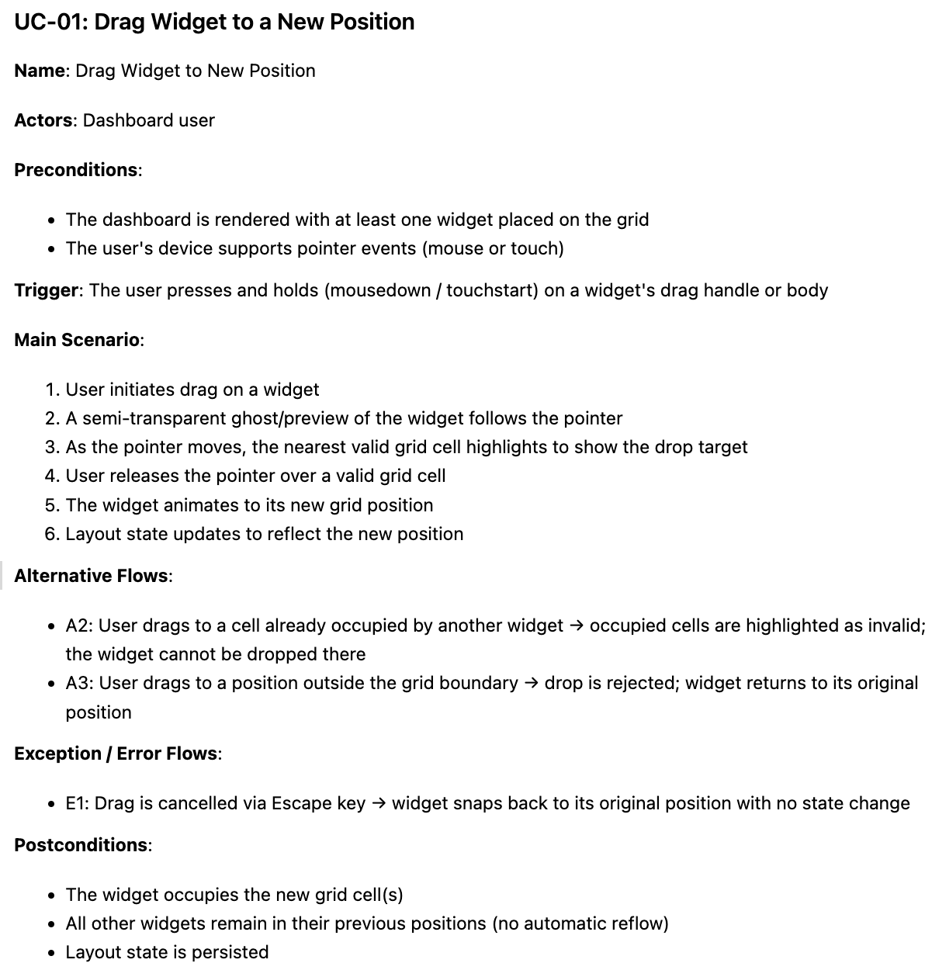
Current problem with OpenSpec
Behaviour Driven Design (BDD) requirements
Huawei uses Use Case Requirements
Huawei requirements are more rigorous than OpenSpec’s
2

Slide 9
Proposal: OpenSpec-HW[5]
Demo
Fork of OpenSpec, enforce use case requirements
Adds command to generate and run tests, create test report
Methodology:
User assumes role of a non-software engineer: “vibe coder”
Use a state-of-the-art agent: Claude code
Agent tasked with building a non-trivial app: widget dashboard
Compare Claude vs OpenSpec vs OpenSpec-HW
2

Slide 10
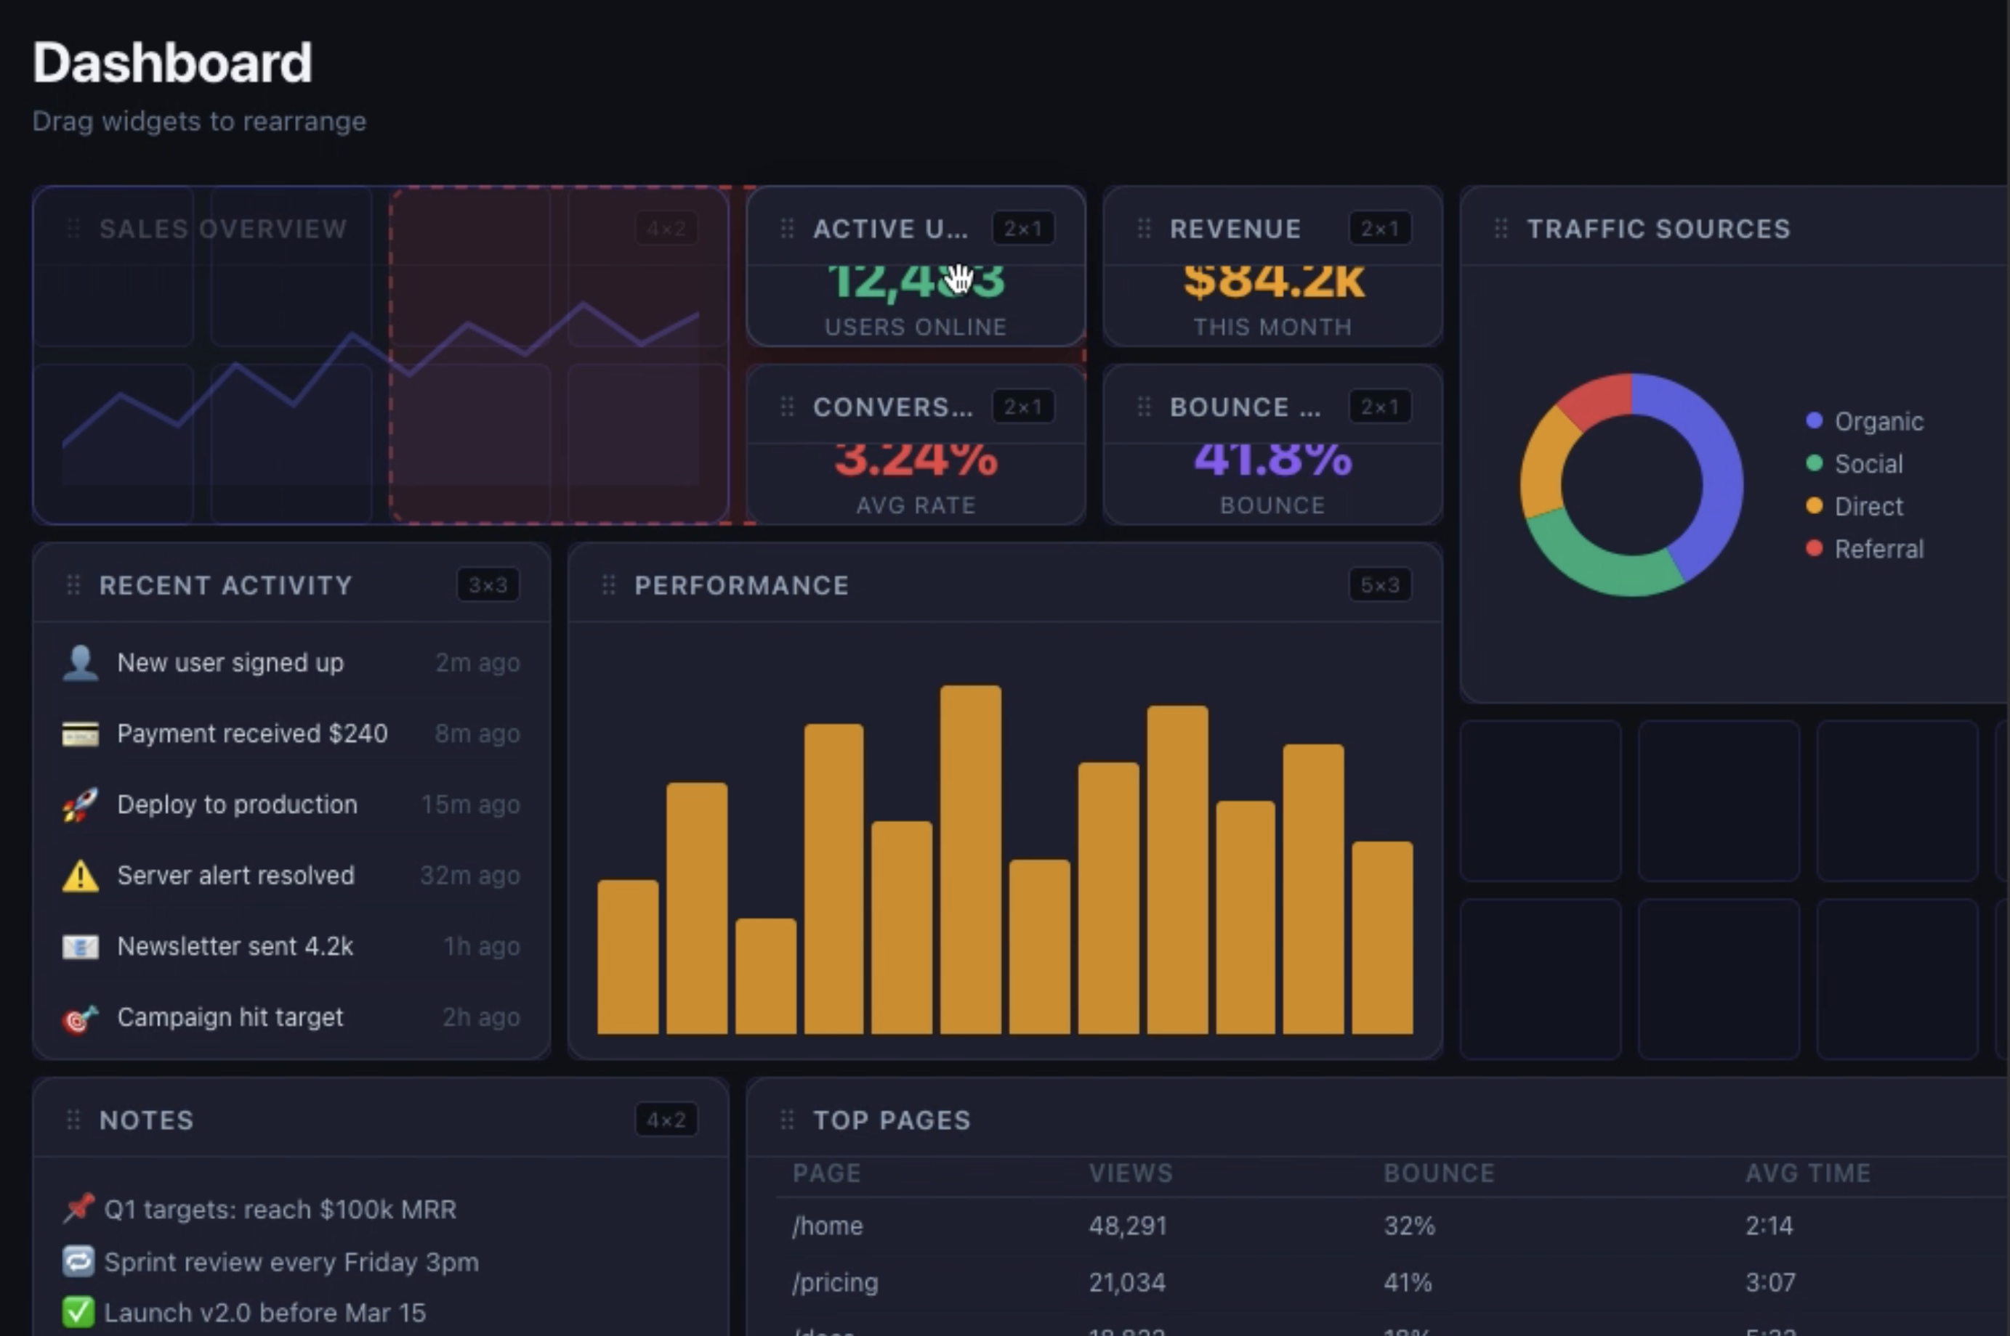
Demo 1: Vanilla Claude Code
Prompt: Build a drag-and-drop dashboard grid in React. I should be able to drag different sized widgets around the screen and snap them to a grid.
Video
Conclusions
Deceptive UI: looks good, but no SE process was followed.
Is this what we want?
Do we want drop shadow?
What happens when grid is occupied? ... etc.
2

Slide 11
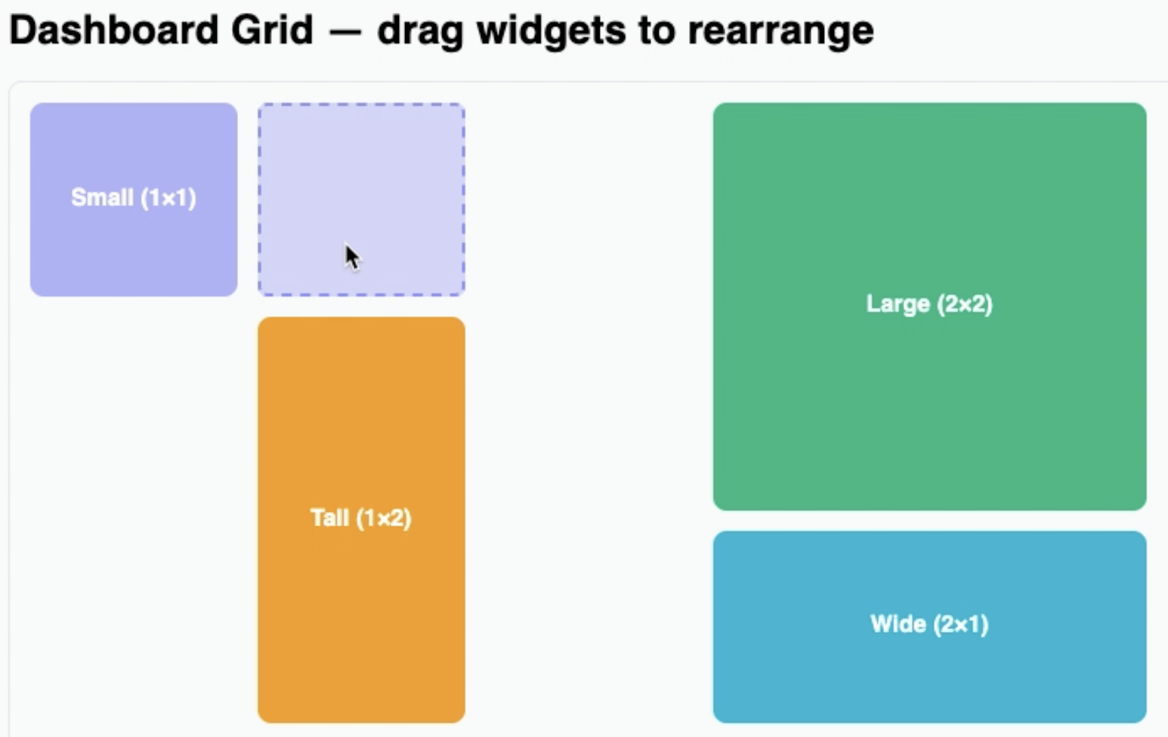
Demo 2: OpenSpec
Same prompt, Video
Process: proposal.md, design.md, tasks.md, implement and archive
Conclusions
Simple UI, but strong SE process
Everything implemented is documented
2

Slide 12
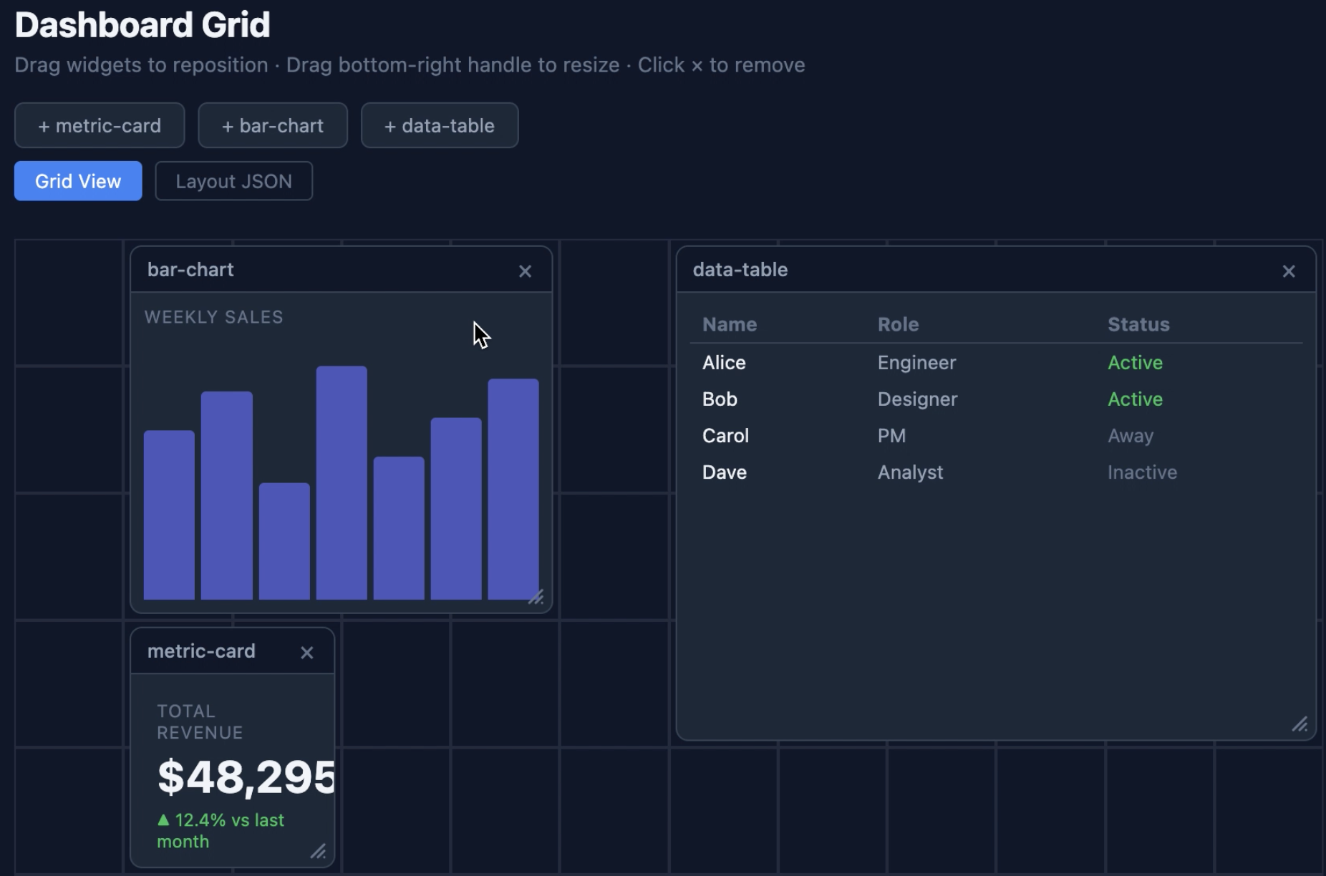
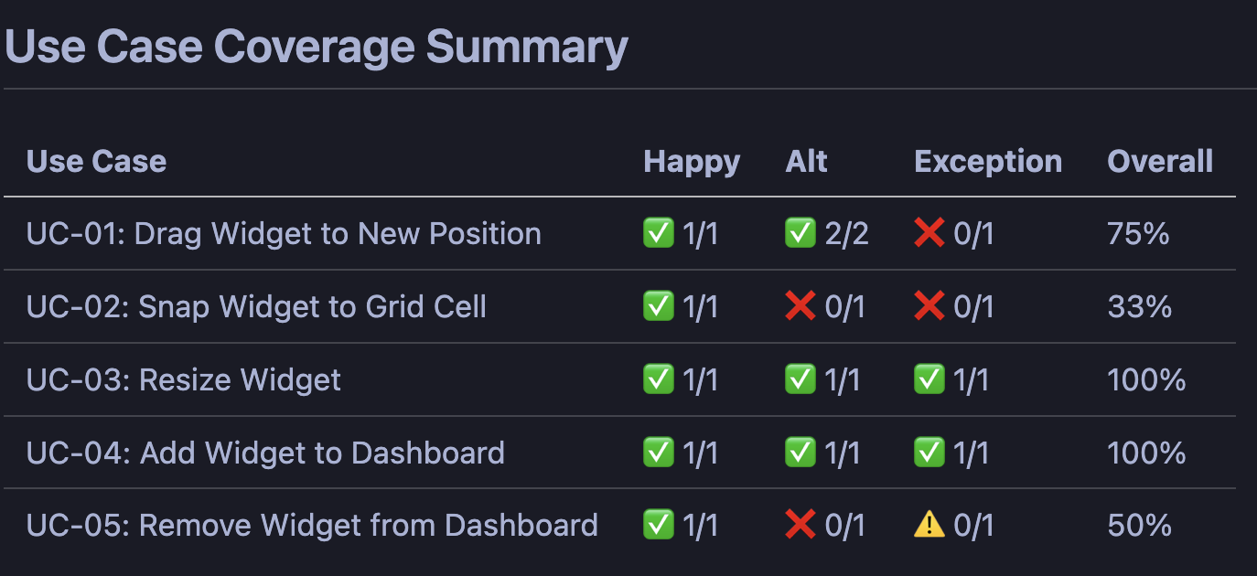
Demo 3: OpenSpec-HW
Same prompt, Video 1 , Video 2
Process: proposal.md, design.md, tasks.md, implement and archive, test
Conclusions
More features with strong SE process
Everything implemented is documented, with alternate flows, exceptions, post conditions, etc
Testing is more rigours, covered and uncovered paths are reported
2

Slide 13
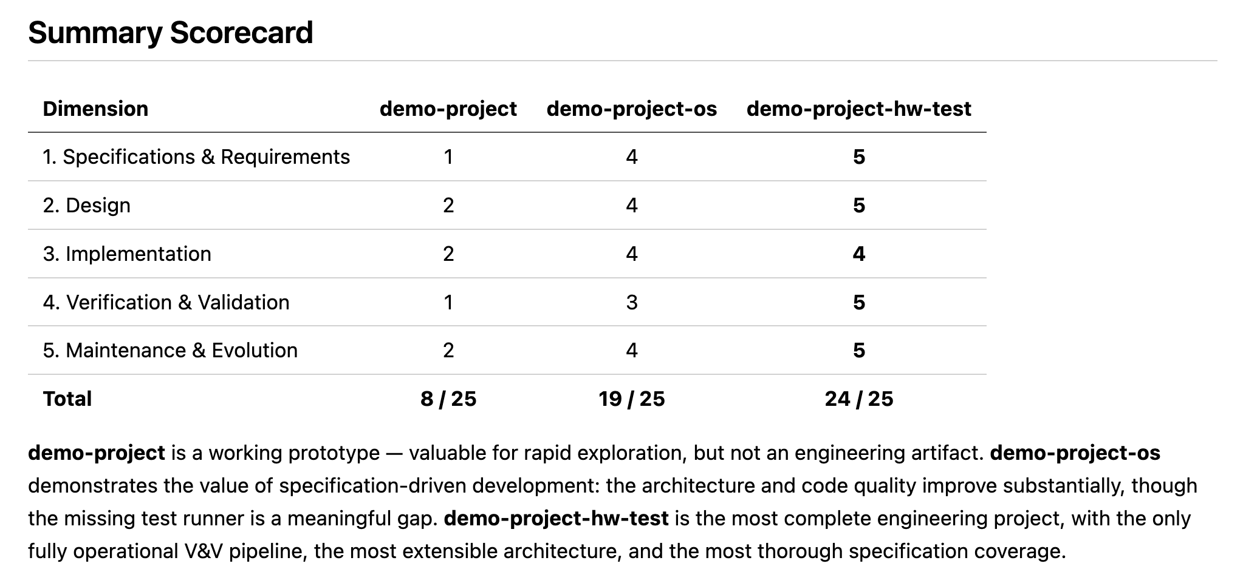
Comparison using claude code:
Full comparison: grade.md
2

Slide 14
Comparison by SE phases
Phase | Vanilla Agent | OpenSpec-HW
Requirements | No explicit elicitation, requirements = initial prompt + optional clarifying questions for AI | Explicitly elicit requirements, converts them to use cases.
Design | Designs created on the fly, reactive to user prompt | Enforces patterns from design.md file
Implementation | Quick, highly dependent on model training and context window | Disciplined, Traceable, Modifications follow a strict tasks.md list. The list maps specific code components (file names, methods, etc) to the feature name.
Verification & Validation | Ad-hoc, Agent may or may not write tests | Traceable, Tests are generated to cover paths in use case requirements
Maintenance & Evolution | Memory dependent, Works only on context window | Traceable, any maintenance is started by a change to spec.md
2

Slide 15
Backup

Slide 16
Comparison by SE phases
Phase | Vanilla Agent | Agent with sub-agents / skills | OpenSpec | SpecKit
Requirements | No explicit elicitation, requirements = initial prompt + optional clarifying questions for AI |  | Explicitly elicit requirements, called “Spec Deltas” in spec.md | Explicitly elicit requirements using /speckit.specify
Design | Designs created on the fly, reactive to user prompt | Enforces patterns from skills and sub-agent.md files | Enforces patterns from design.md file | Enforces patterns using /speckit.plan
Implementation | Quick, highly dependent on model training and context window | Defensive, run refactoring, linters, tests, to check each modification | Traceable, Each code modification is mapped to lines in the spec spec.md file. | Systematic, follows task list in tasks.md
Verification & Validation | Ad-hoc, Agent may or may not write tests | Automated, using test-driven development ‘tdd’ skill | Traceable, Tests are generated to verify assertions in the spec file | Automated & traceable, using a “review & acceptance” checklist
Maintenance & Evolution | Memory dependent, Works only on context window | Skills driven, Skills may be used to summarize project | Traceable, any maintenance is started by a change to spec.md | Unclear
2

Slide 17
Comparison with simulated example
Scenario: You need to add a "Remember Me" checkbox to an existing login page. If checked, the session should persist for 30 days instead of the default 24 hours.
2

Slide 18

Vanilla agent
Workflow: User --> Writes prompt in terminal / IDE
Process:
Reads “CLAUDE.md”
May or may not plan the edits, ask user to approve plan
Implement edits
Risk without guardrails:
May hardcode 30-days value
May ignore security pattern for login
May not write tests
2

Slide 19
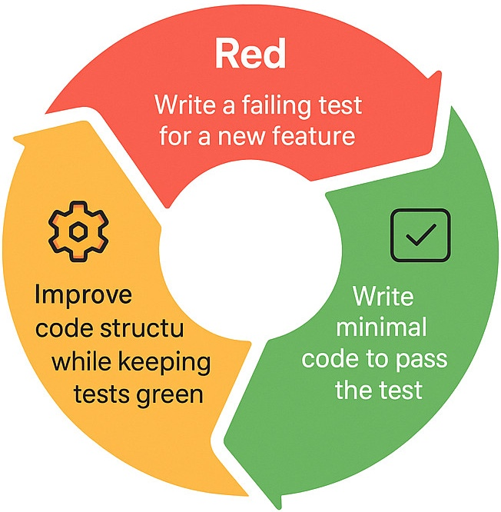
Agent with skills / sub-agents[1]
Workflow: run /plan “prompt”, /tdd, /code-review
Process:
Planner agent creates a plan
tdd skill triggers “Red-green-refactor” loop
Implement, following language rules (rules/typescript)
Runs user-defined “hooks”, e.g., linter, git, etc.
Review code using rules in code-review.md
Risk: instructions occupy context window, reduce code window, increases cost
[1] https://github.com/affaan-m/everything-claude-code
2

Slide 20

OpenSpec [2]
&
Workflow: run /openspec:proposal “prompt”
Process:
Read specs for this feature. e.g., auth/spec.md
Generate spec delta between specs and prompt
Create proposal.md, user reviews and accepts
Agent generates code for spec delta
Risk:
Tests not a natural part of the process
User must critically read the proposal
[2] https://openspec.dev/
2

Slide 21

TODO [3]
&
Claude code, grade the 3 projects, based on SE
Add command to generate test cases, the -hw version with use cases should genrate better tests due to expcetions.
[3] https://github.com/github/spec-kit
2

Slide 22
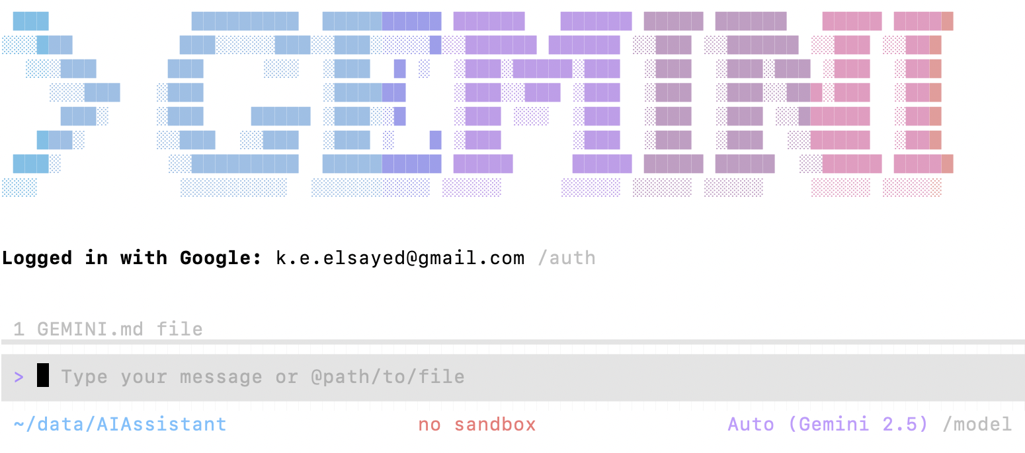
Experiment: Do coding agents follow good SE process out-of-box?
Methodology:
User assumes role of a non-software engineer: “vibe coder”
Use a state-of-the-art agent: gemini-cli
Agent tasked with building a non-trivial app: Pomodoro
Evaluate the SE practices employed by agent and final result quality
<number>

